Slide 1

WEB development tools in the industry

Slide 2

About me
David Flores-Condezo
Chief tutor and a lecturer of COMP1710/6780
6+ Years experience developing website in the public and private sector.
Interests: Human Computer Interaction (HCI), Web content delivery.
Email: David.flores-condezo@anu.edu.au

Slide 3
Web development lifecycle

Slide 4
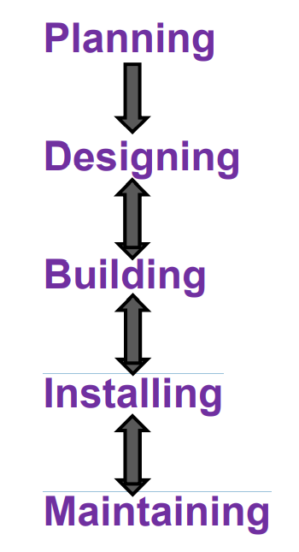
Recap Weeks 2 - 4

Slide 5
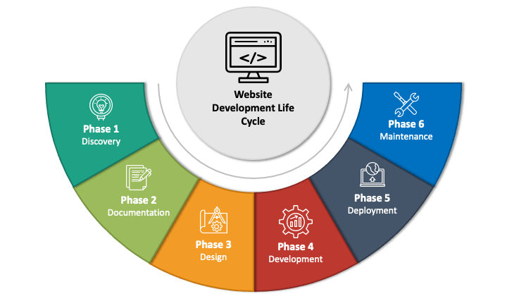

Slide 6
Cms, CRM, INTRANET, saas, paAs AND OTHER BUZZ WORDS

Slide 7
CONTENT MANAGEMENT SYSTEMS (CMS)
Foundation of an industry standard website
CMS is a software application that allows users to collaborate in the creation, editing, and production of digital content: web pages, blog posts, etc.
Facilitate content editing
Not just HTML and CSS, variety of different technologies

Slide 8
POPULAR CMS

Slide 9
POPULAR CMS
Wordpress
Drupal
Wix
Squiz
Adobe Experience and more

Slide 10
Software as a service (sass)
Software as a service (or SaaS) is a way of delivering applications over the Internet—as a service. Instead of installing and maintaining software, you simply access it via the Internet, freeing yourself from complex software and hardware management.
SaaS applications are sometimes called Web-based software, on-demand software, or hosted software. Whatever the name, SaaS applications run on a SaaS provider’s servers. The provider manages access to the application, including security, availability, and performance.

Slide 11
Platform as a service (paas)
In the Platform-as-a-Service (PaaS) model, developers essentially rent everything they need to build an application, relying on a cloud provider for development tools, infrastructure, and operating systems.
PaaS vastly simplifies web application development; from the developer's perspective, all backend management takes place behind the scenes.

Slide 12
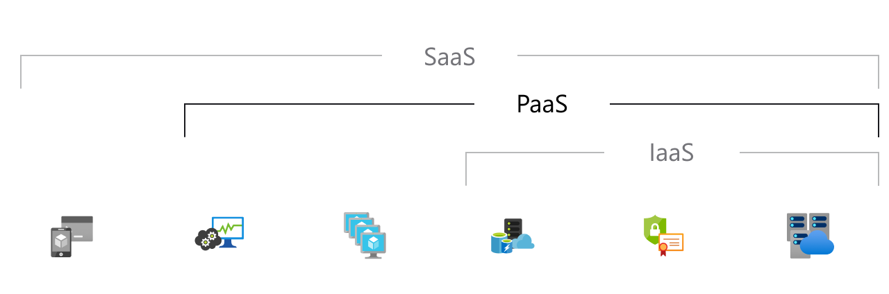
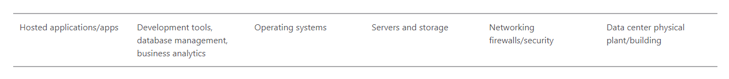
Image from Microsoft Azure dictionary

Slide 13
SAAS VS PAAS
If a SaaS customer is like someone renting a house, then a PaaS customer is like someone renting all the heavy equipment and power tools necessary to rapidly build a house, if the tools and equipment were continually maintained and repaired by their owner. -- Cloudflare

Slide 14
Hosting
Where your website lives, where all the files of your website are located.
PARTCH is a hosting platform

Slide 15







Hosting

Slide 16
Developing for cms

Slide 17
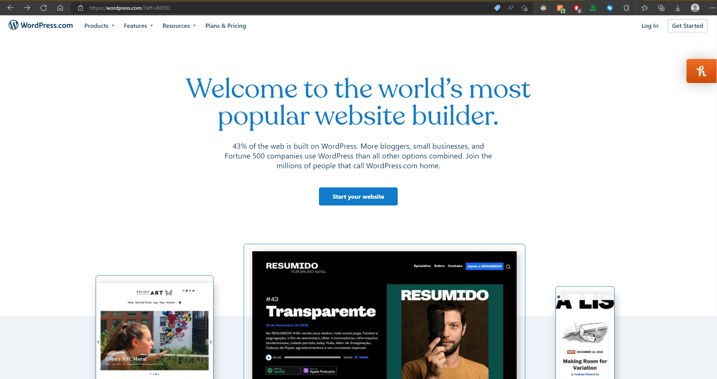

Slide 18
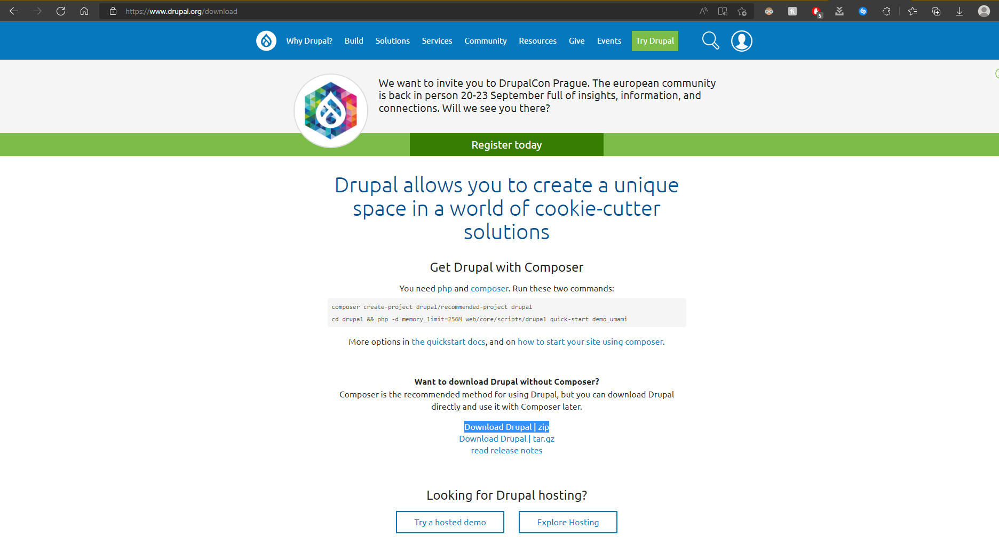

Slide 19
drupal

Slide 20
THEMES
The look and feel of your website
Not just CSS
Design
Content Layout
Sometimes Content specifics (PDFS, MEDIA, ETC..)

Slide 21
modules
The functionality of your website
Can choose from existing or create your own
Javascript, Python, PHP…

Slide 22
Workflows and Permissions
Different types users
Multiple permissions to set
Not every user needs access to everything

Slide 23
Deployment*

Slide 24
Was uploading to partch complicated?

Slide 25
IT’S COMPLICATED

Slide 26
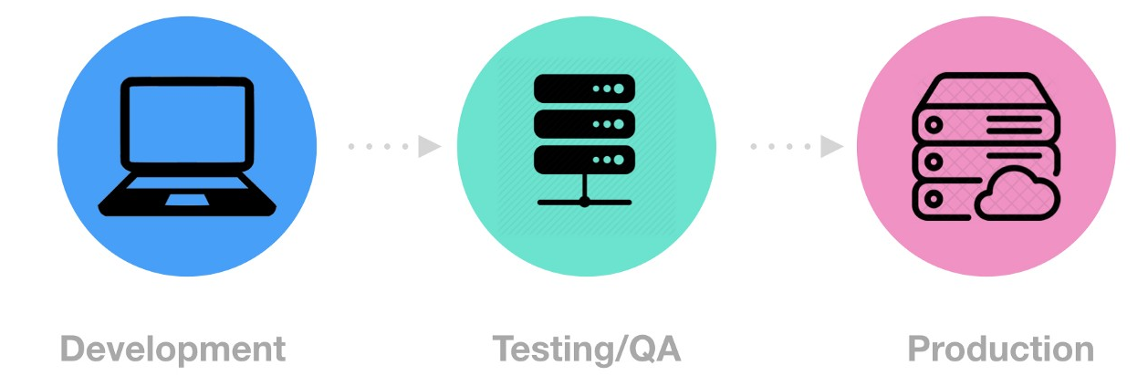
environments

Slide 27
Environments + cms
Scalable
Multiple databases
Easy to get out of sync
Needs management

Slide 28
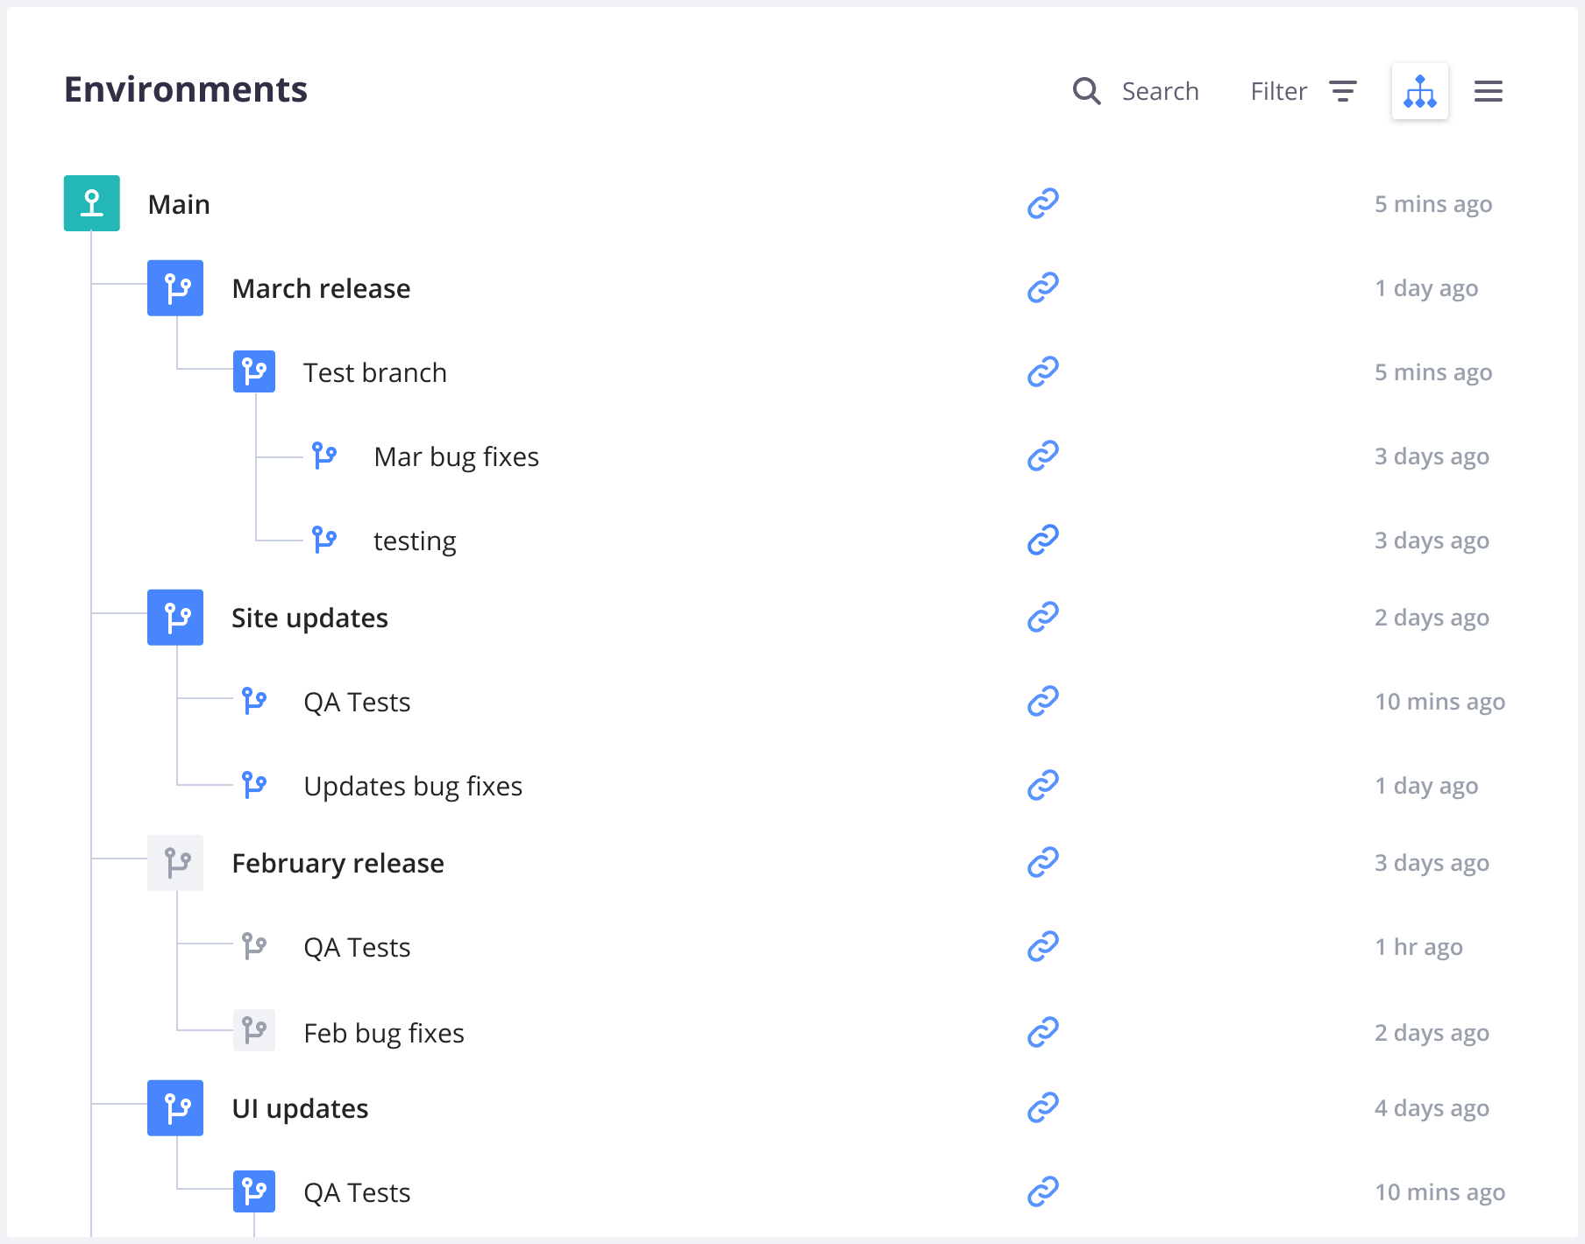
Environments + CMS EXAMPLE

Slide 29
Version control

Slide 30

Version control
GIT VERSION CONTROL
Accountability
Reverting to previous versions
Commit history
Collaboration

Slide 31
Environments + cms + version control

Slide 32

Environments + cms + version control

Slide 33
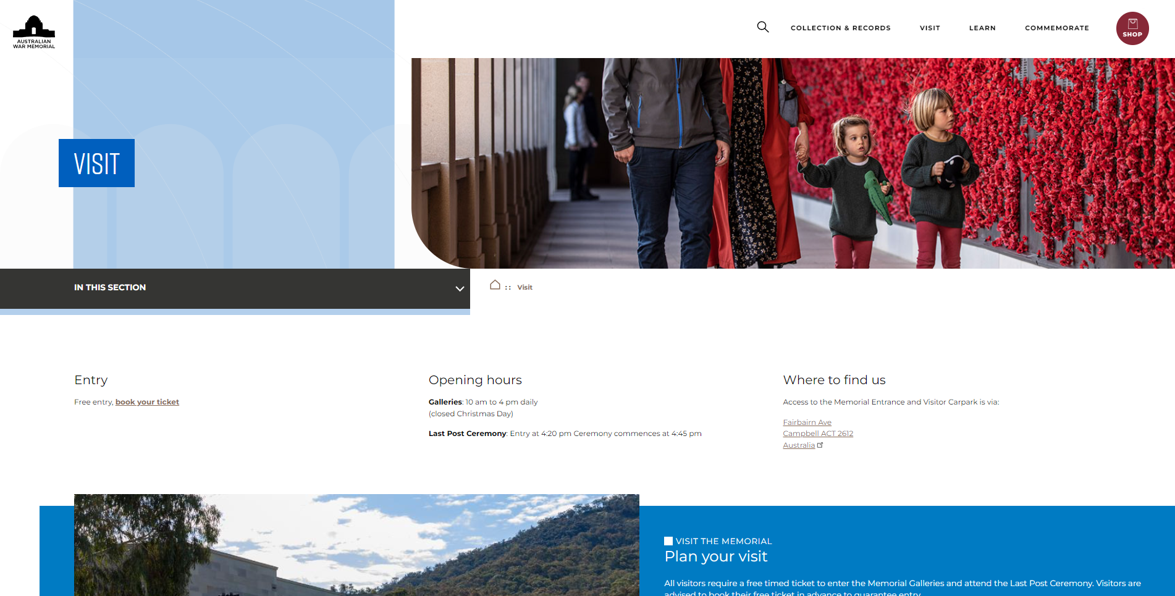
Case study: Australian war memorial

Slide 34
Case study: Australian war memorial
Redevelopment
Discovery
Requirements
Design
Development
UAT and Remediation
Deployment
Training and Documentation

Slide 35
Recap
Importance of CMS
SAAS and PAAS
Developing in a CMS
Hosting
Deployment

Slide 36
Q&A

